Slide 1

Air Quality Analysis in New York City
Project Team 3 Team Members: Krishna, Michael, Halima, Nicole

Slide 2
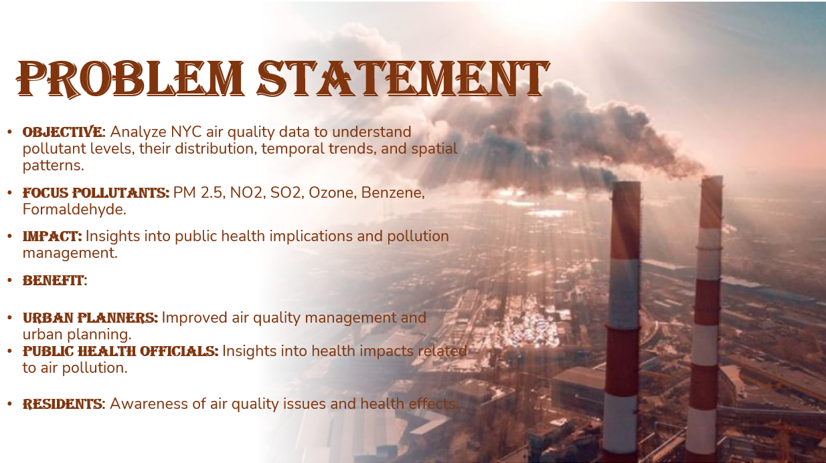

Slide 3
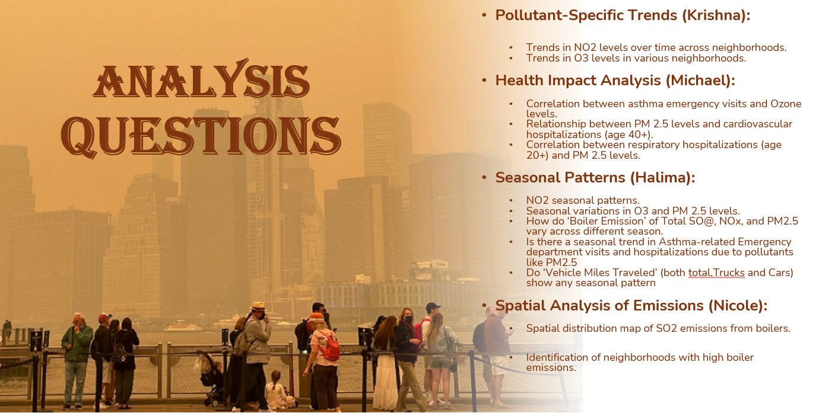

Slide 4
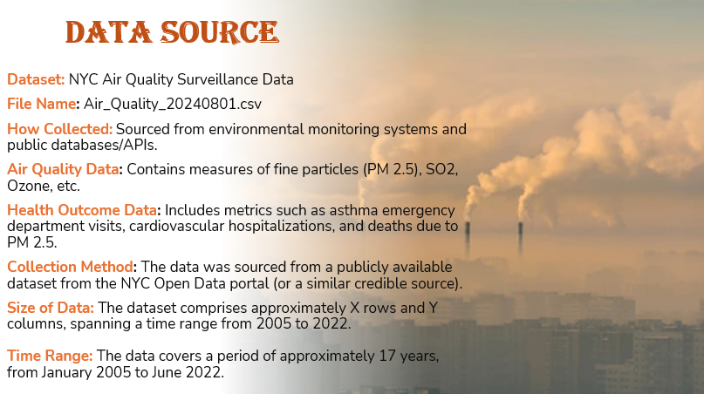

Slide 5
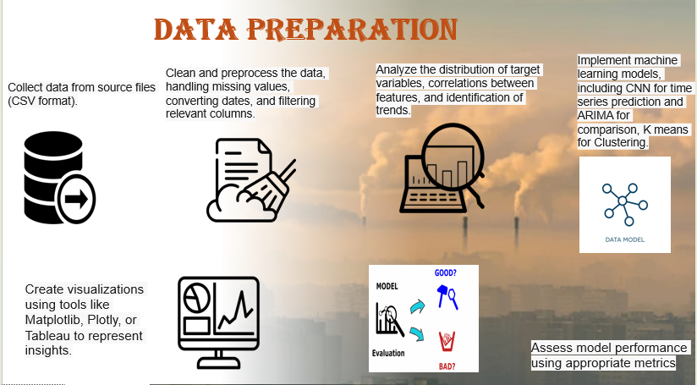

Slide 6
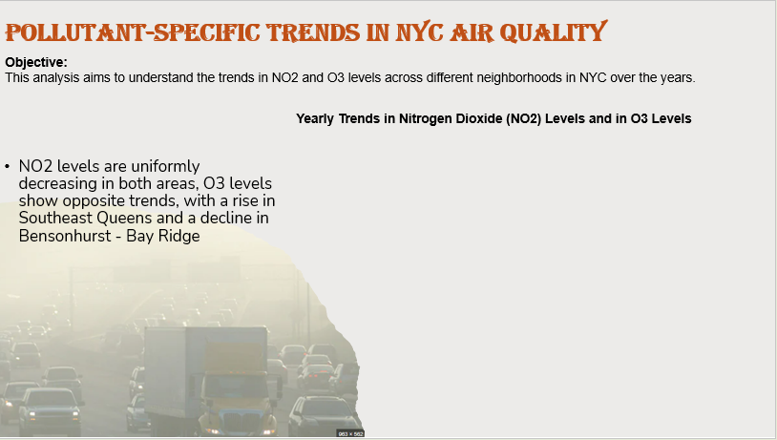
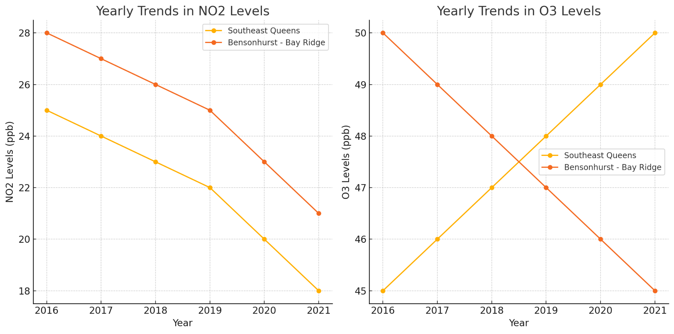

Slide 7
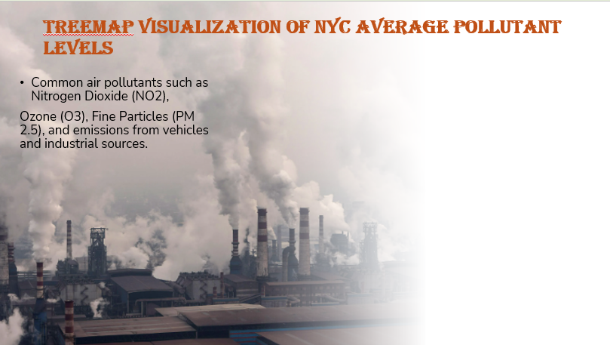
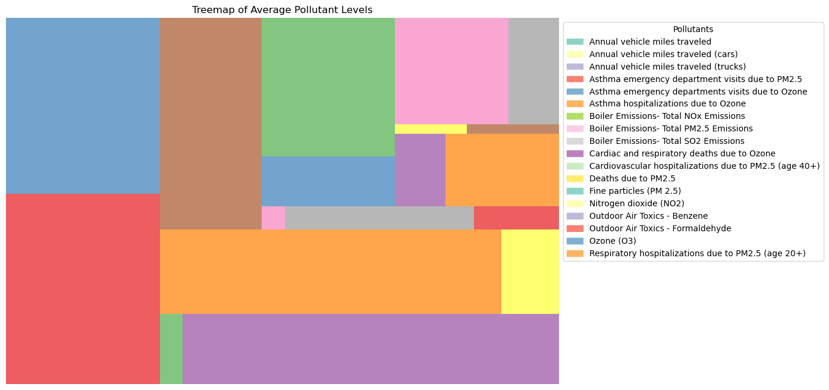

Slide 8
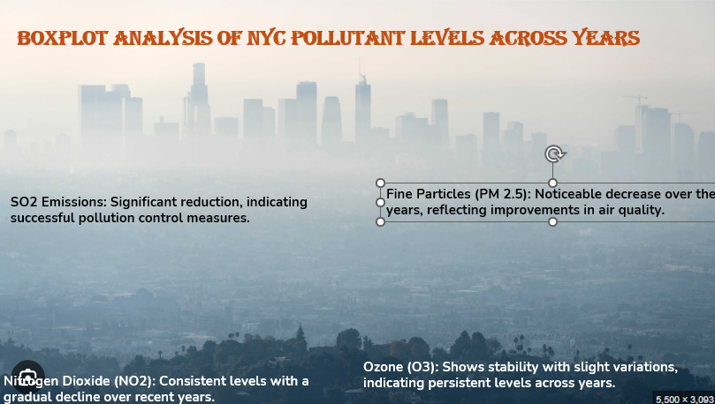
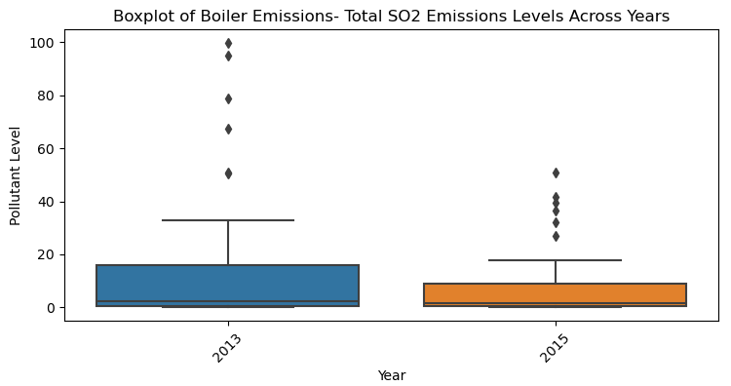
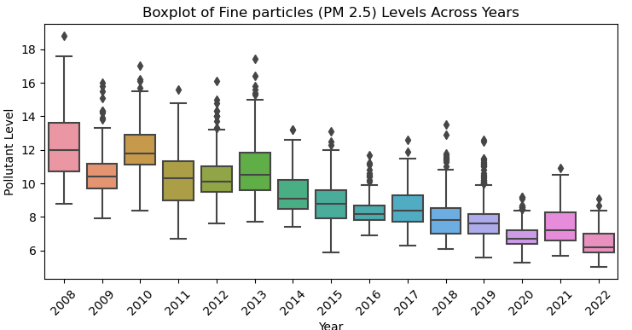
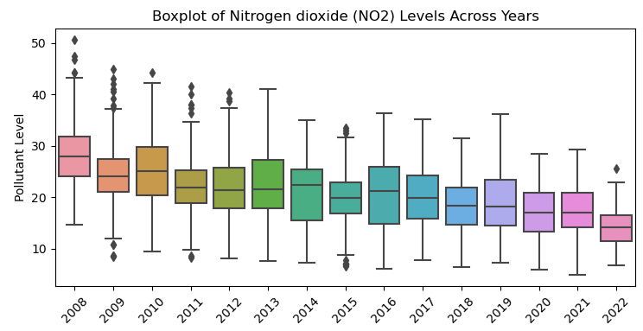
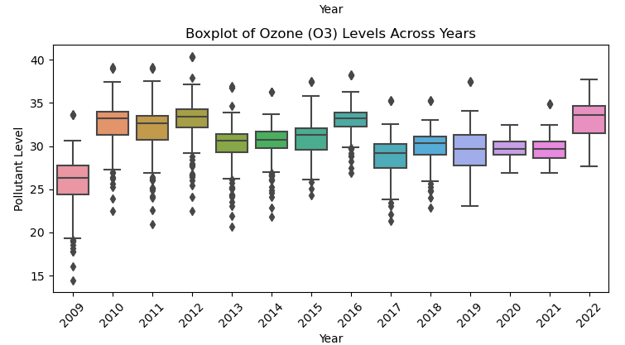

Slide 9
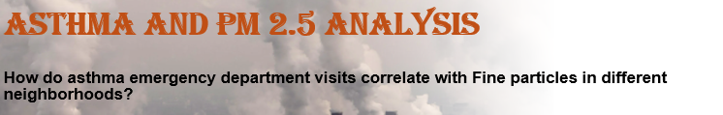
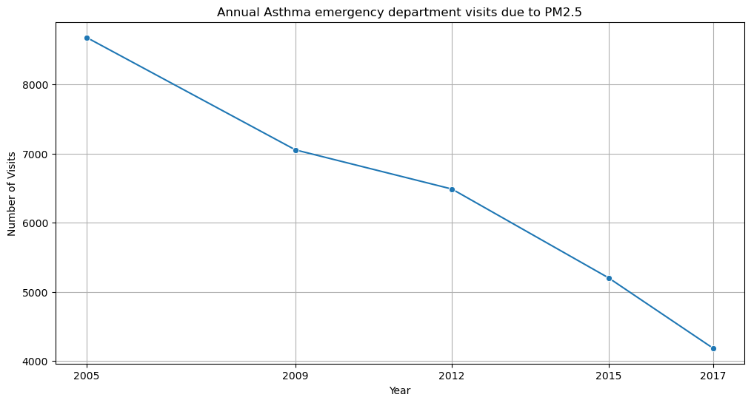
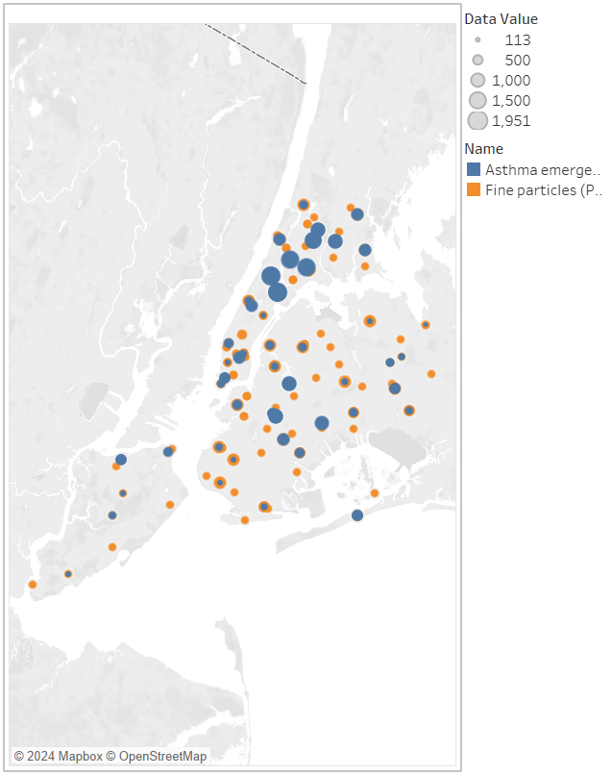
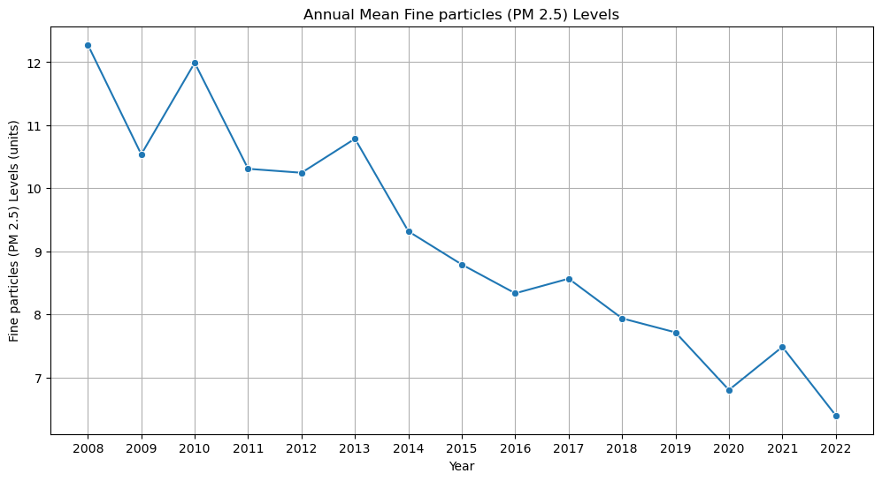
Asthma and PM 2.5 Analysis
Statistical Analysis
Correlation Coefficient:
The correlation coefficient of 0.9699 indicates a very strong positive correlation
The p-value of 0.0301 suggests that this relationship is statistically significant,
Tableau Visualization
This map show the monitoring of PM 2.5 levels in urban areas,
particularly in neighborhoods prone to high levels of P.25 pollution.
Public health interventions could be targeted more effectively by correlation between air quality and asthma emergencies

Slide 10

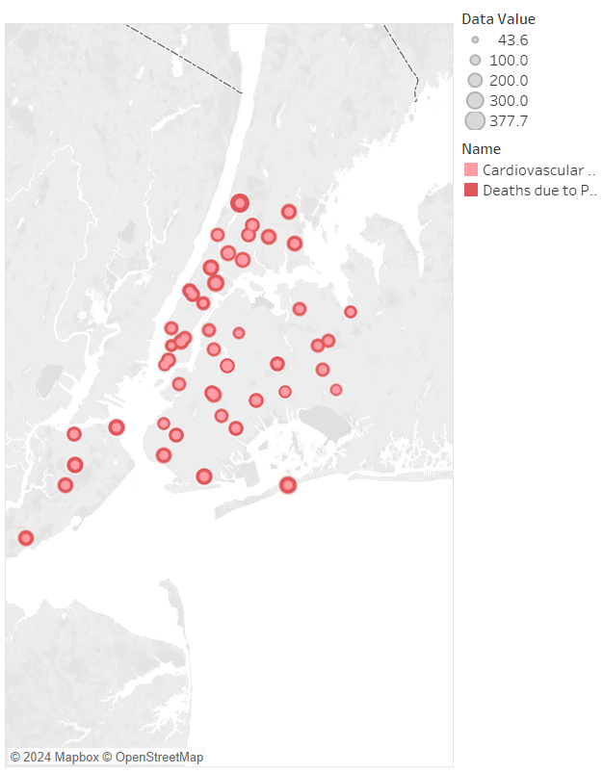
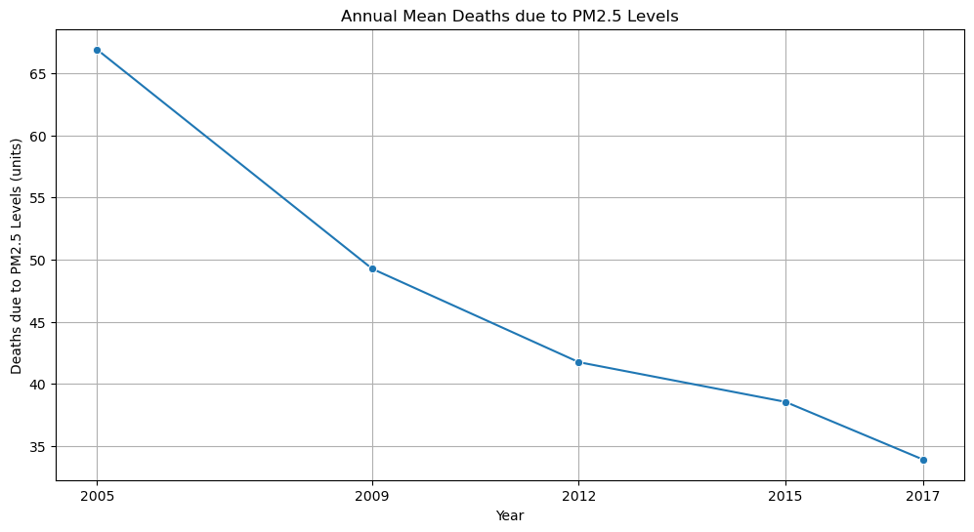
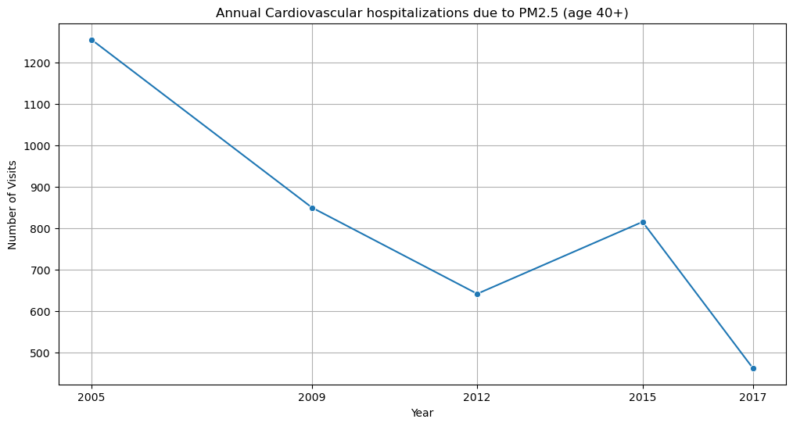
Cardiovascular and PM 2.5 Analysis
Statistical Analysis
Correlation Coefficient:
The correlation coefficient of 0.9384 indicates a very strong positive correlation
The p-value of 0.0182 suggests that this relationship is statistically significant,
Tableau Visualization
This analysis reveals a significant association between PM2.5 exposure and cardiovascular hospitalizations among individuals aged 40 and above in New York City.
Critical for public health to focus on reducing PM2.5 levels in urban areas where vulnerable populations are at higher risk

Slide 11
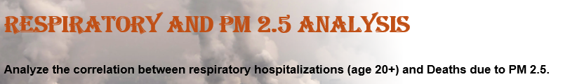
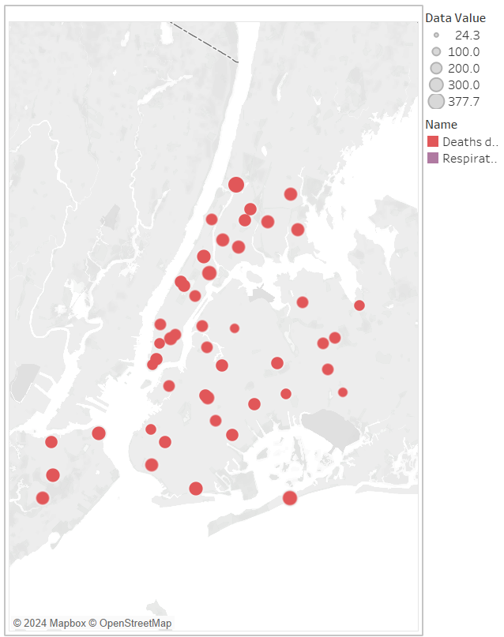
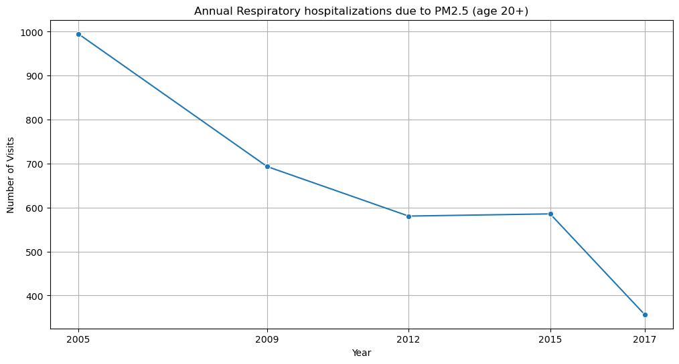
Respiratory and PM 2.5 Analysis
Tableau Visualization
The analysis reveals a noteworthy association in higher levels of PM2.5 in urban areas that is linked to increased rates of respiratory hospitalizations among 20+ year olds and related mortality
Statistical Analysis
Correlation Coefficient:
The correlation coefficient of 0.9736 indicates a very strong positive correlation
The p-value of 0.0051 suggests that this relationship is statistically significant,
These results are profound for public health strategies aimed at reducing respiratory-related hospitalizations and mortality

Slide 12
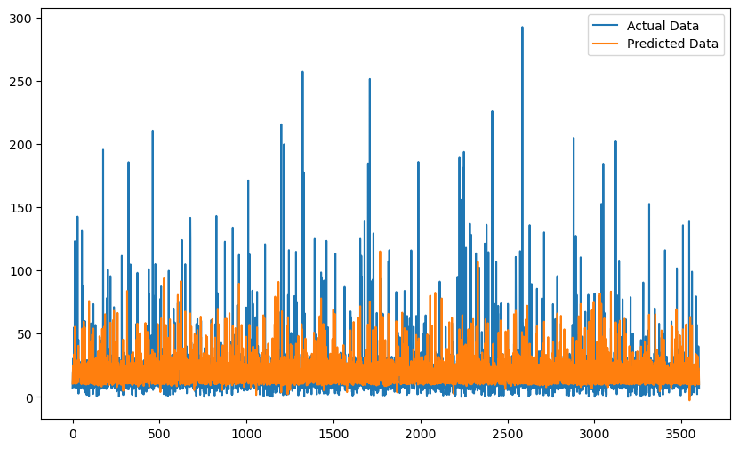
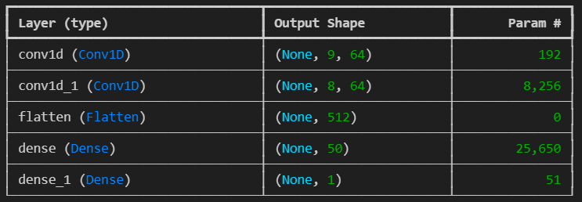
This section is about modeling
CNN model used to predict a single value (Data Value feature column) based on the past sequence of data. The model uses convolutional layers to capture patterns within the input sequence, flattens this data, and then uses dense layers to make the final prediction.
Test Loss: 0.002528771525248885
Total params: 34,149 (133.39 KB)
Trainable params: 34,149 (133.39 KB)
Non-trainable params: 0 (0.00 B)
Final test loss of approx 0.0025. This indicates that the model predicts values reasonably well given the data it was trained on

Slide 13
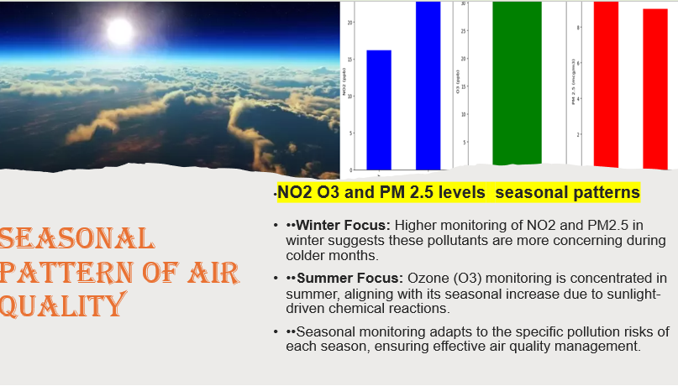
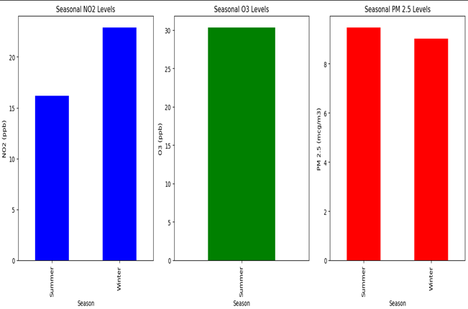
SEASONAL PATTERN OF AIR QUALITY
•NO2 O3and PM 2.5 levels seasonal patterns
••Winter Focus: Higher monitoring of NO2 and PM2.5 in winter suggests these pollutants are more concerning during colder months.
••Summer Focus: Ozone (O3) monitoring is concentrated in summer, aligning with its seasonal increase due to sunlight-driven chemical reactions.
••Seasonal monitoring adapts to the specific pollution risks of each season, ensuring effective air quality management.

Slide 14
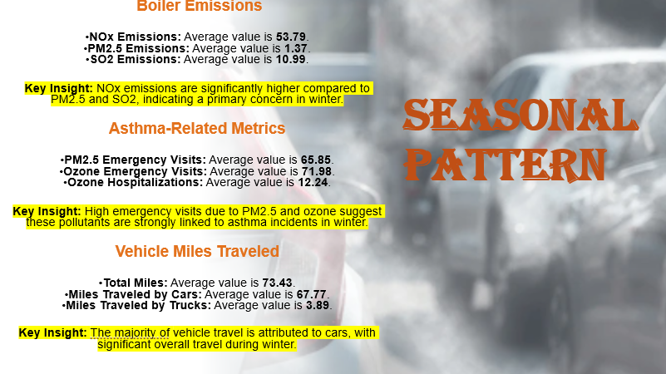
SEASONAL PATTERN
Boiler Emissions
NOx Emissions: Average value is 53.79.
PM2.5 Emissions: Average value is 1.37.
SO2 Emissions: Average value is 10.99.
Key Insight: NOx emissions are significantly higher compared to PM2.5 and SO2, indicating a primary concern in winter.
Asthma-Related Metrics
PM2.5 Emergency Visits: Average value is 65.85.
Ozone Emergency Visits: Average value is 71.98.
Ozone Hospitalizations: Average value is 12.24.
Key Insight: High emergency visits due to PM2.5 and ozone suggest these pollutants are strongly linked to asthma incidents in winter.
Vehicle Miles Traveled
Total Miles: Average value is 73.43.
Miles Traveled by Cars: Average value is 67.77.
Miles Traveled by Trucks: Average value is 3.89.
Key Insight: The majority of vehicle travel is attributed to cars, with significant overall travel during winter.

Slide 15
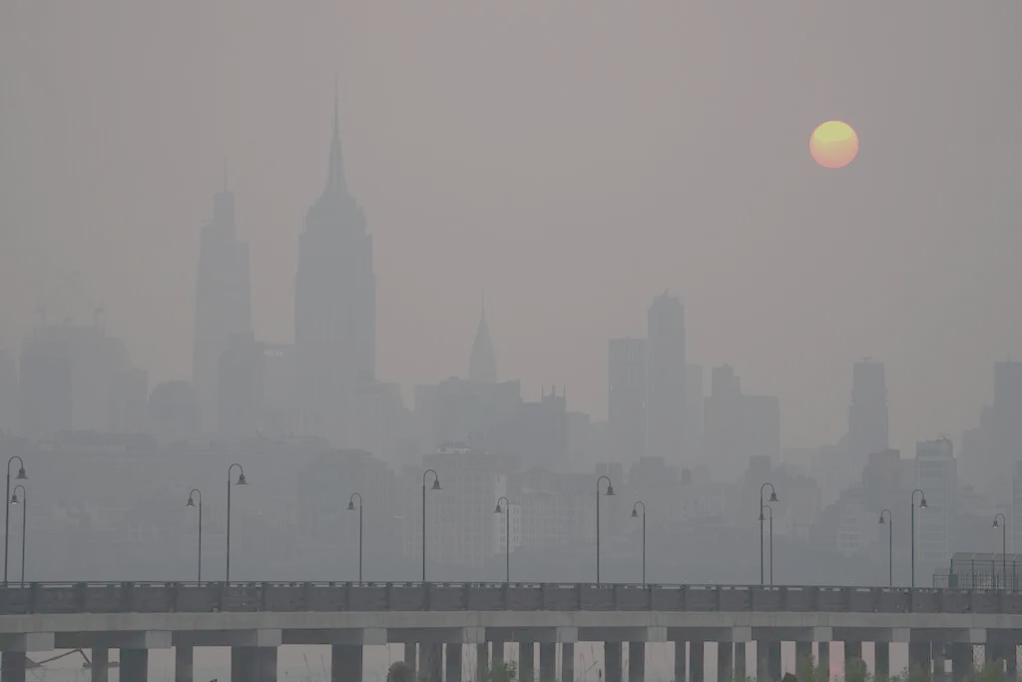
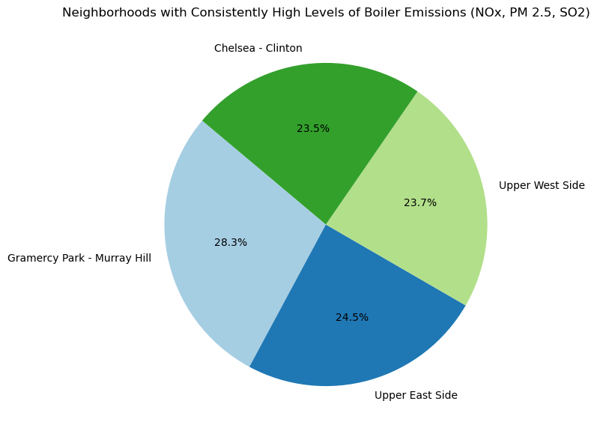
Spatial Analysis of Emissions
The purpose of this analysis is to identify neighborhoods that consistently experience elevated levels of boiler emissions, specifically focusing on nitrogen oxides (NOx), particulate matter (PM 2.5), and sulfur dioxide (SO2).

Slide 16
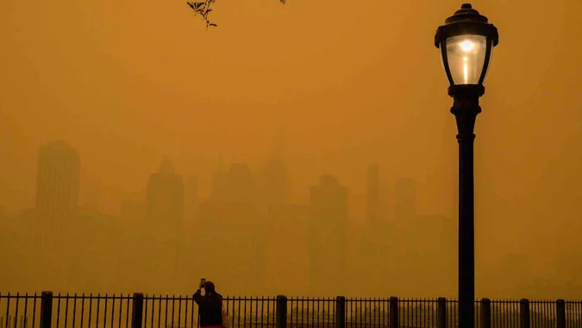
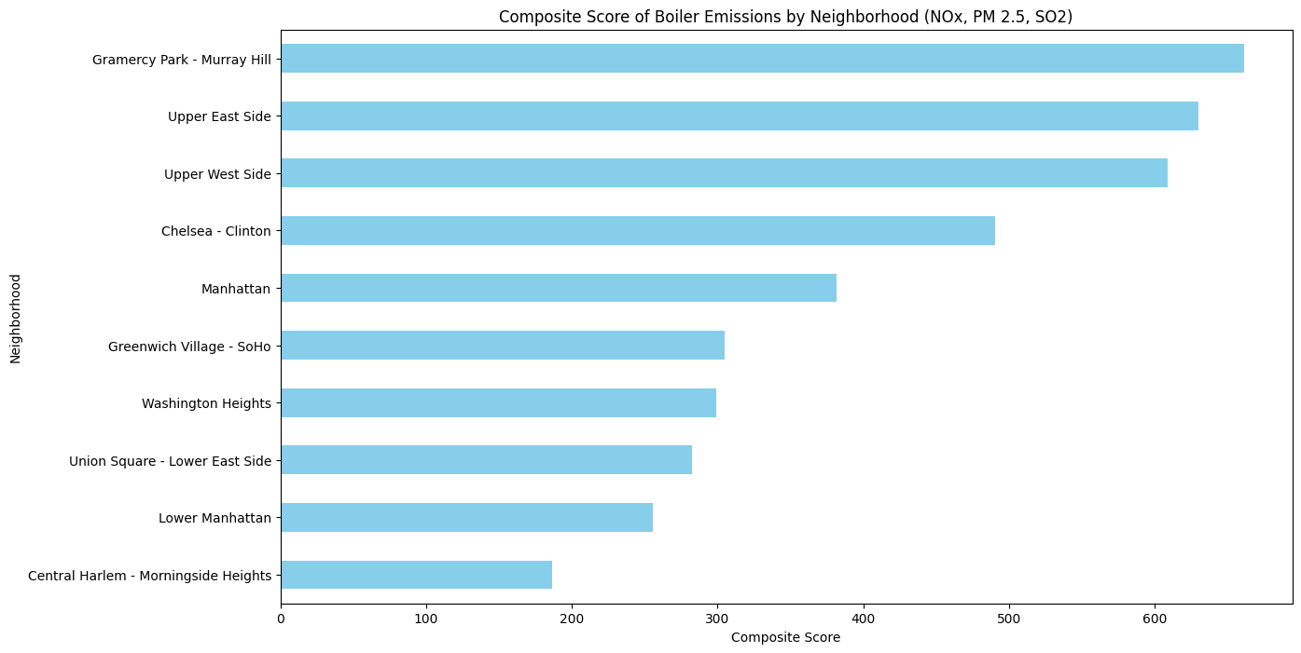
Boiler Emissions by Neighborhood
High Emission Neighborhoods:
Gramercy Park - Murray Hill Upper East Side and Upper West Side
Moderate Emission Areas:
Chelsea - Clinton, Manhattan, and Greenwich Village - SoHo
Washington Heights and Union Square - Lower East Side
Lower Emission Neighborhoods:
Lower Manhattan and Central Harlem - Morningside Heights
Implications for Policy and Intervention:
Targeting High Emission Areas: The neighborhoods with the highest composite scores (Gramercy Park - Murray Hill, Upper East Side, Upper West Side) should be prioritized for policy interventions aimed at reducing boiler emissions. This could include retrofitting older boilers, promoting cleaner heating technologies, or introducing stricter emissions regulations.

Slide 17
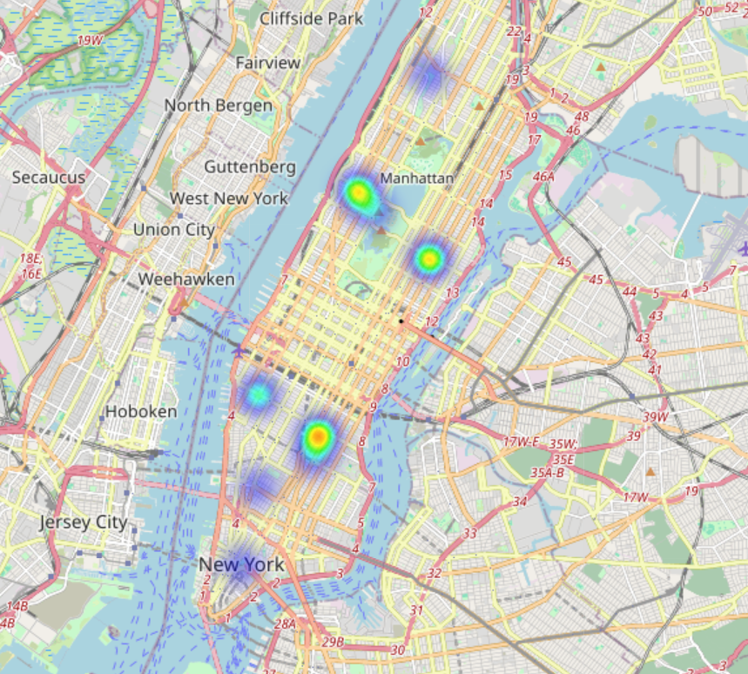
Spatial Analysis of Emissions
The heatmap shows that boiler emissions are most intense in the core commercial and densely populated residential areas of Manhattan. This geographical pattern suggests that urban density, building age, and the concentration of commercial activity are significant contributors to boiler emissions.
In this case, as expected the boiler emissions are highest in Midtown Manhattan and Upper East Side and Upper West Side

Slide 18
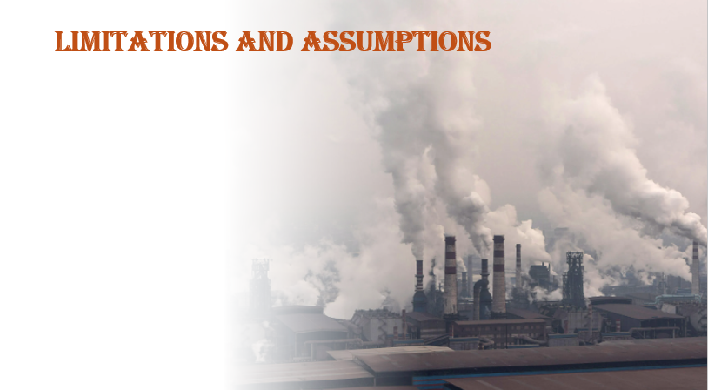
Limitations:
The model may not capture all external factors affecting health outcomes (e.g., socioeconomic status).
The dataset may contain missing or incomplete data, affecting the accuracy of analyses and visualizations.
The dataset might not cover all neighborhoods or regions comprehensively, leading to incomplete spatial analysis.
Geographic granularity may vary, with some regions having more detailed data than others.
The CNN model may not generalize well to new data; cross-validation and data augmentation could improve this.
data gaps or uneven distribution of measurements across seasons may impact the accuracy of the conclusions.
Assumptions:
Assume the data provided is accurate and reflects real-world conditions.
Assume the relationship between air quality and health outcomes is stable over time.
Trends observed may not fully account for external factors like economic changes, policy interventions, or unusual environmental events.
Assumes that the geographical boundaries and names used are consistent over time and accurately represent the areas analyzed.
The time series data used in modeling (e.g., for PM 2.5 levels and health outcomes) is assumed to be stationary

Slide 19

What Went Well:
The model accurately captured trends in the data.
Effective use of CNNs for time series prediction.
What Could Be Better:
More time could be spent on hyperparameter tuning.
Expanding the dataset to include more variables could improve accuracy

Slide 20

Extend the Work:
Incorporate more features (e.g., socioeconomic factors).
Explore more advanced deep learning architectures.
Increase the temporal granularity of data (e.g., daily instead of monthly).
Develop systems for real-time air quality monitoring and prediction to enable immediate responses and adjustments.
Conduct comprehensive studies to understand the health impacts of specific pollutants and implement targeted health interventions.

